Slide 2
Brogan Open Water Classic
2020

Slide 3
Brogan Open Water Classic
2020
USMS Middle-Distance Open Water National Championship

Slide 4
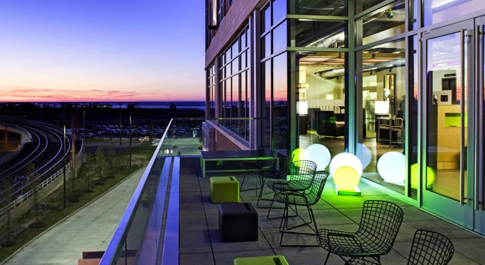
Brogan Open Water Classic
2020
USMS Middle-Distance Open Water National Championship
Host Hotel

Slide 5
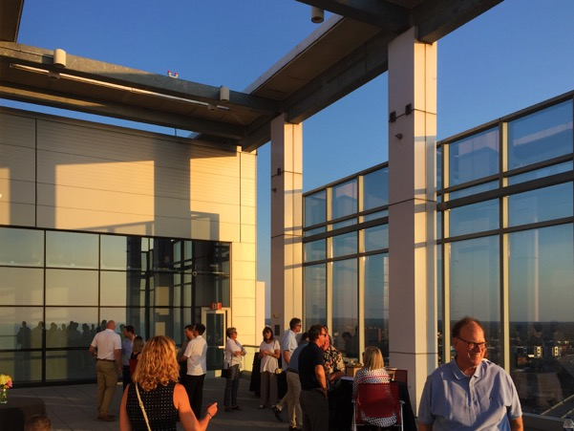
Brogan Open Water Classic
2020
USMS Middle-Distance Open Water National Championship
Host Hotel
Friday Evening Social

Slide 6
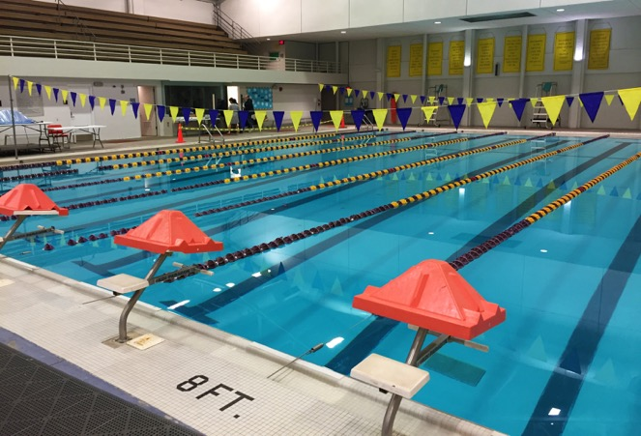
Brogan Open Water Classic
2020
USMS Middle-Distance Open Water National Championship
Host Hotel
Friday Evening Social
Open Water Clinic

Slide 7
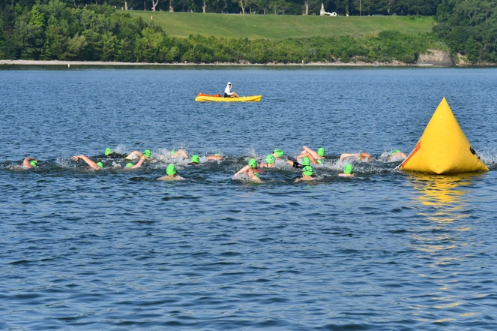
Brogan Open Water Classic
2020
USMS Middle-Distance Open Water National Championship
Host Hotel
Friday Evening Social
Open Water Clinic
1-mile and 2-mile Races
Photo by Patrick Wilson

Slide 8
Brogan Open Water Classic
2020
Entries opened February 1
63 entries by May 4
Cleveland MetroParks cancelled all events
All entries refunded = $363
Permit applied to 2021

Slide 9
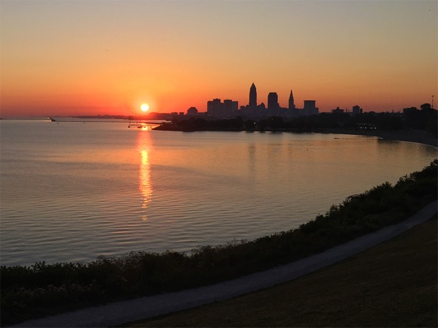
Brogan Open Water Classic
2021
July 17 at Edgewater
Half-mile, 1-mile and 2-mile races
89 entries as of June 4
Price increases June 16
Received $809 from USMS Great Lakes Zone

Slide 10
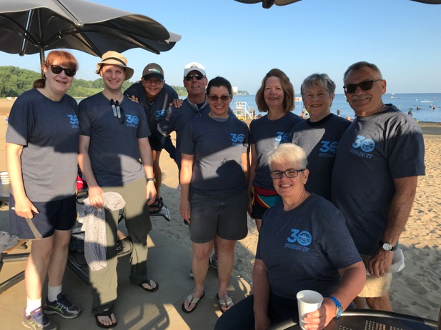
Brogan Open Water Classic
2021
We still need lots of volunteers!
Go to “Volunteers” at ohiomasters.com/ brogan-owc to sign up.

Slide 11
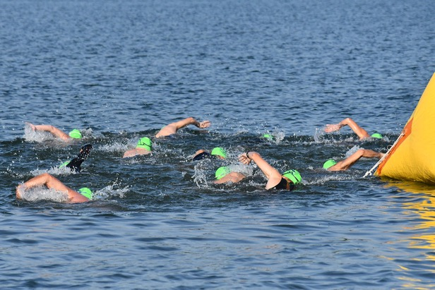
Brogan Open Water Classic
2022
July 16 at Edgewater
USMS Sprint-Distance Open Water National Championship
Contract has been signed and we’re ready to have a great event!
Photo by Patrick Wilson

Slide 12
See you all on July 17!

