Slide 1
Annual Meeting - June 4, 2022

Slide 2
Annual Meeting Agenda
President’s Opening Remarks
Approval of Minutes from Annual Meeting, June 5, 2021
Approval of Minutes – Board Meeting – March 23, 2022
Officer Reports:
Secretary – Kristen
Treasurer – Bob
Vice President – Andrew
Brogan Open Water Meet Director - Chuck
President – Ann
Elections
Old Business: None Scheduled
New Business
Adjorn Annual Meeting
Next Annual Meeting: June 2023
Next Board Meeting: TBD

Slide 3
JULY 9, 2022
EDGEWATER BEACH

Slide 6
CONGRATULATIONS!
Level 1 Coach
Mark Stewart
In progress
Marisa Celeste
Peter Finefrock
Gabby Kariotakis

Slide 7
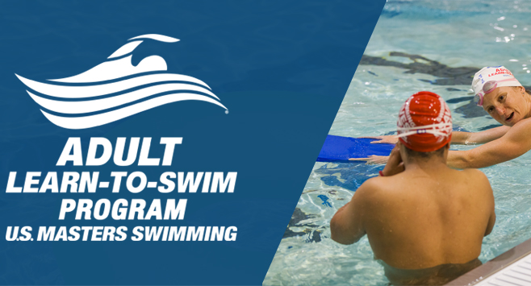

Slide 8
CONGRATULATIONS!
Kris Meekins
Mark Stewart
Marcia Whelan
Pam Young

Slide 9
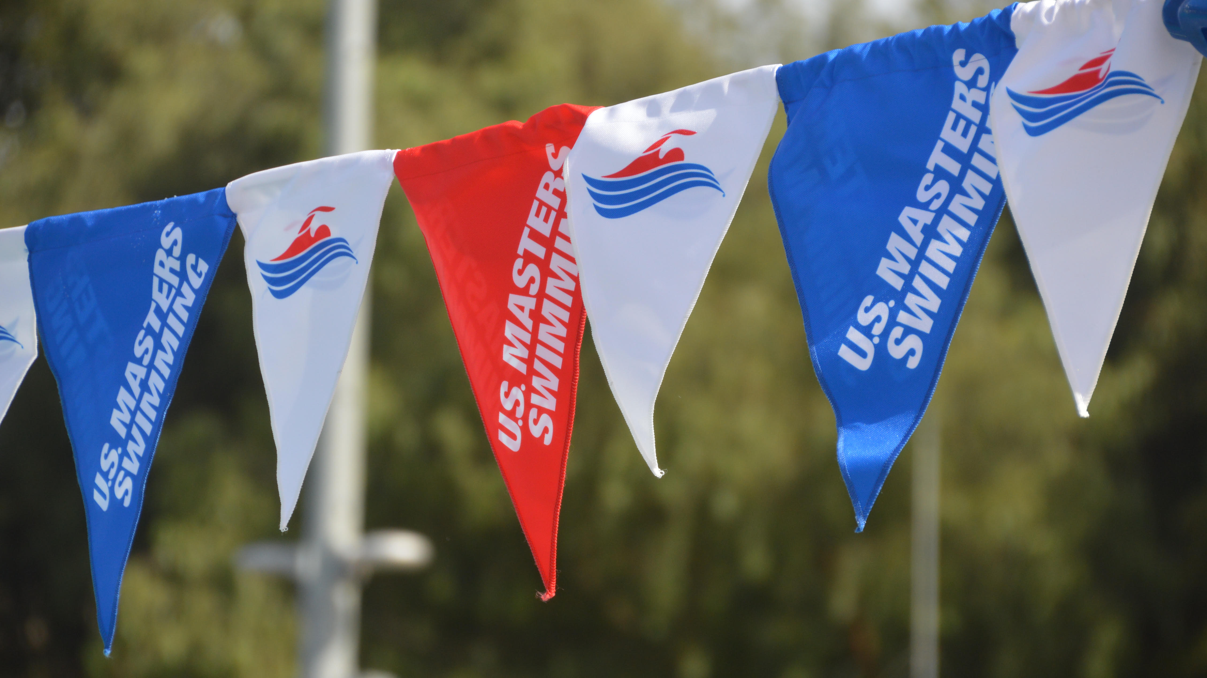

Slide 11
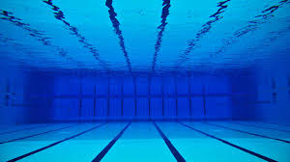

Slide 12
2021 INDIVIDUAL
ALL-AMERICAN
Luise Easton – 1500 FREESTYLE
Kristen Troyer – 800 & 1500 FREESTYLE
Yoshi Oyakawa – 100 BACKSTROKE

Slide 13
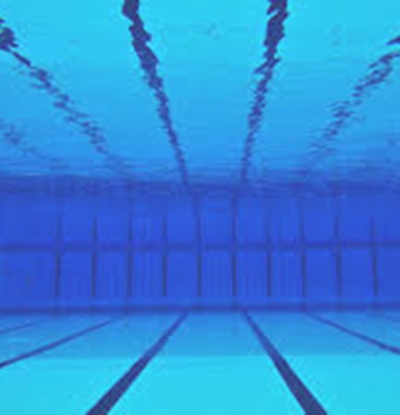
2021
IRON PERSON
&
SUPER
IRON PERSON

Slide 16
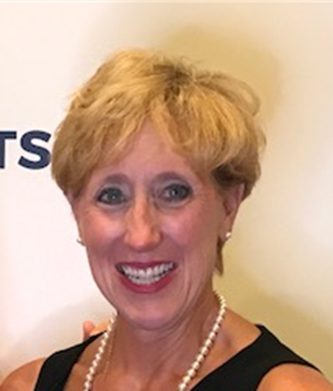
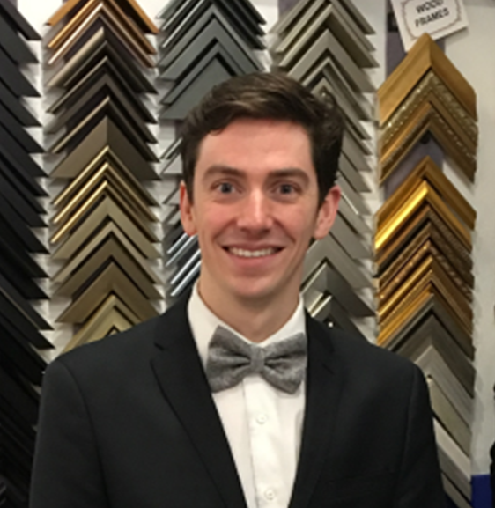
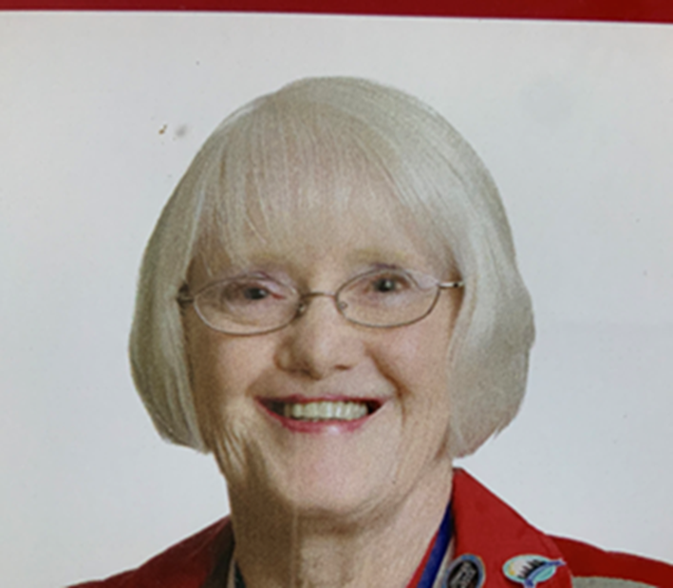
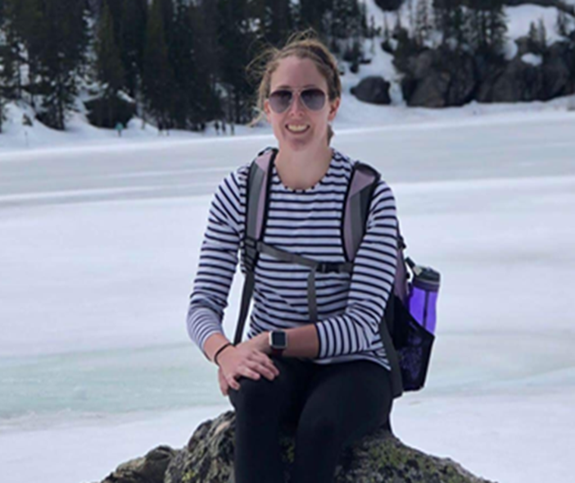
President
Ann Marshfield
Vice President
Andrew McCollister
Anne Hegnauer
Ashley Leahy

Slide 18
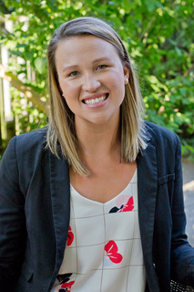
Candidate for President
Sara Tillie
Masters swimmer – 5 years
Lifelong Swimmer and Triathlete Newbie!
Health Education Specialist at Lorain County Public Health
Loves to find ways to turn everyday activities into friendly competitions

Slide 19
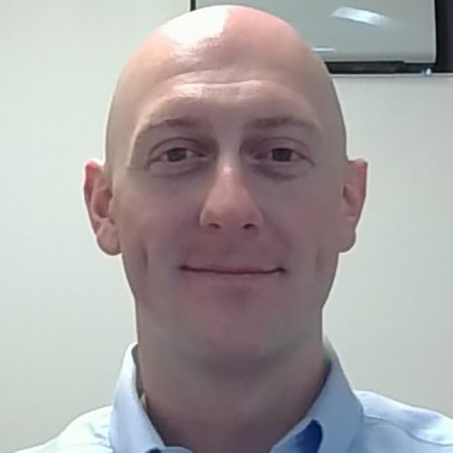
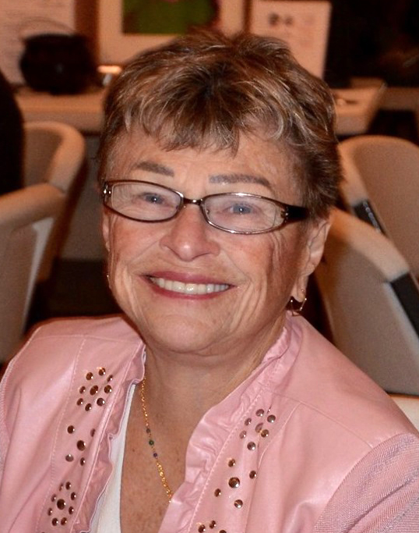
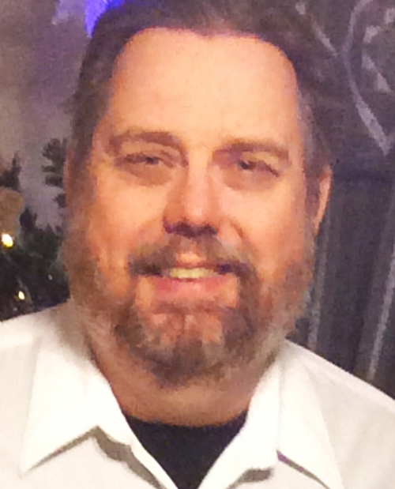
For 2-year Terms
Joe Collum
Candidates for Trustee
Luise Easton
Duane Grassell

Slide 20
Candidate for Trustee
Joe Collum
New Masters swimmer
Triathlete In Training
Desires to be welcoming and supportive
Has a sweet tooth
Makes his own ice cream!

Slide 21
Candidate for Trustee
Luise Easton
Fierce Triathlete and USMS Swimmer
15 USMS All-American Honors
1 USMS All-Star Honor
2021 Aquathlon World Champion!
Experienced in all aspects of swimming and well positioned to serve on the board.
Retired High School teacher

Slide 22
Candidate for Trustee
Duane Grassell
O*H*I*O Masters Member for 40 Years
Advocates for non-traditional swimming events
Desires to “Give Back”
Retired Math Teacher

Slide 23
For 1-year Term
Candidates for Trustee
Andrew McCollister

Slide 24
Candidate for Trustee
Andrew McCollister
Board Trustee for 4 years
Vice President for 2 years
Swimming for 23 years
Desires to continue working with the Board to help Old Hearts Inspire Others

Slide 25
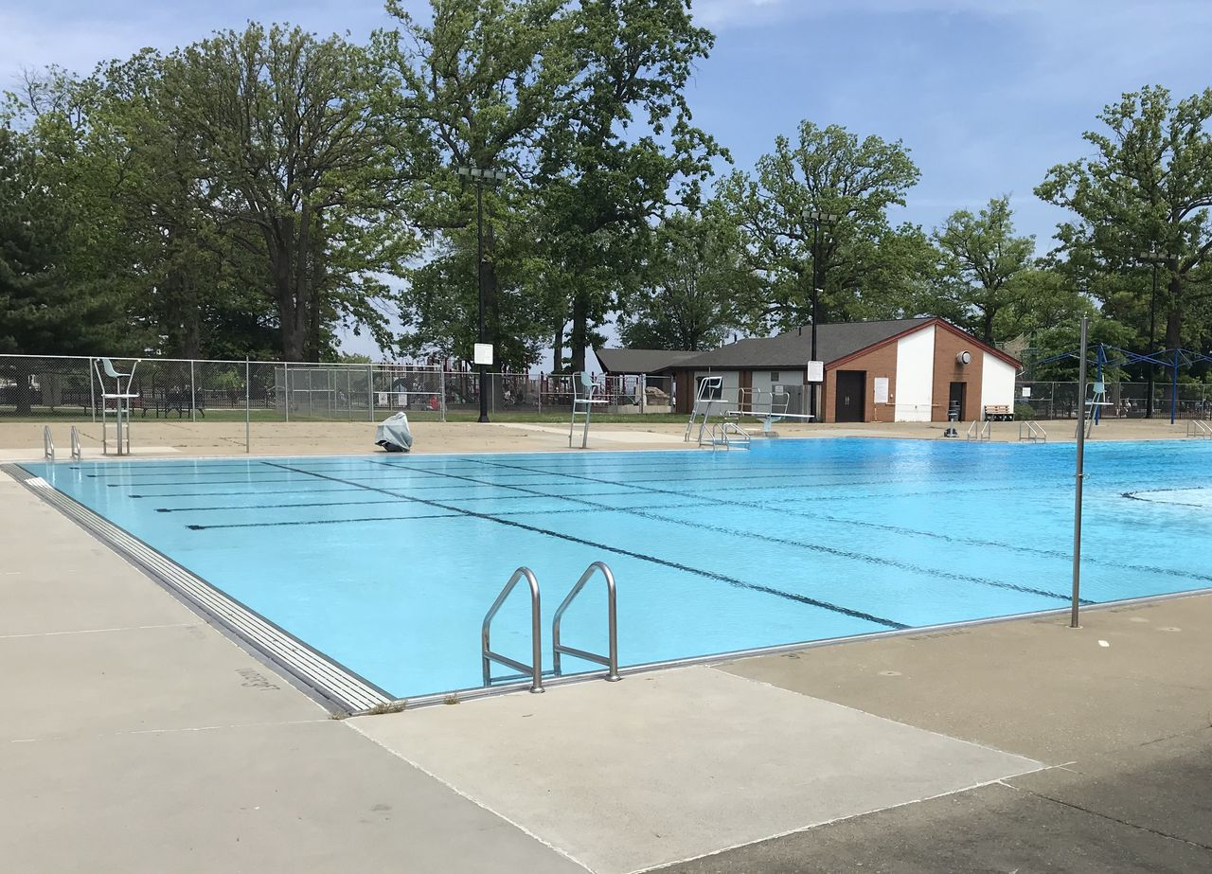
Foster Pool!!! Starting June 8th
Monday: 8:30-9:30 pm
Tuesday: (Still at Lakewood) 6:00-7:15am
Wednesday: 8:30-9:30 pm
Thursday: 8:30-9:30 pm
Saturday: 7:30-9:00 am
Sunday: 10:00-11:30 am

Slide 27
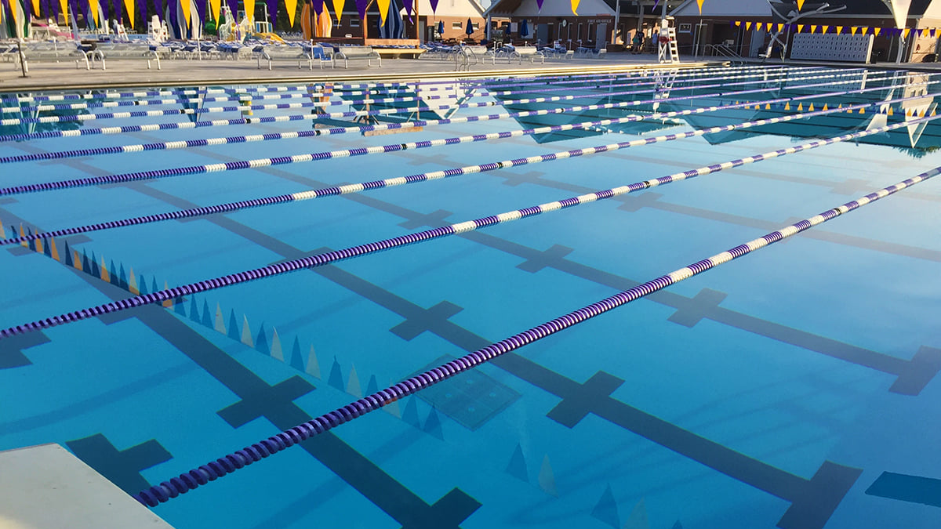
End of Summer Spectacular
LCM Swim
Avon
Saturday
August 27

Slide 28
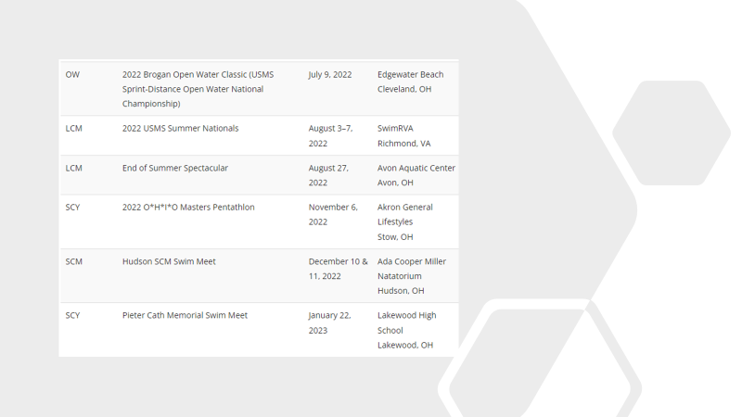
Upcoming
Events

Slide 29
May 15 – September 15
Any 50 Meter Pool

Slide 30
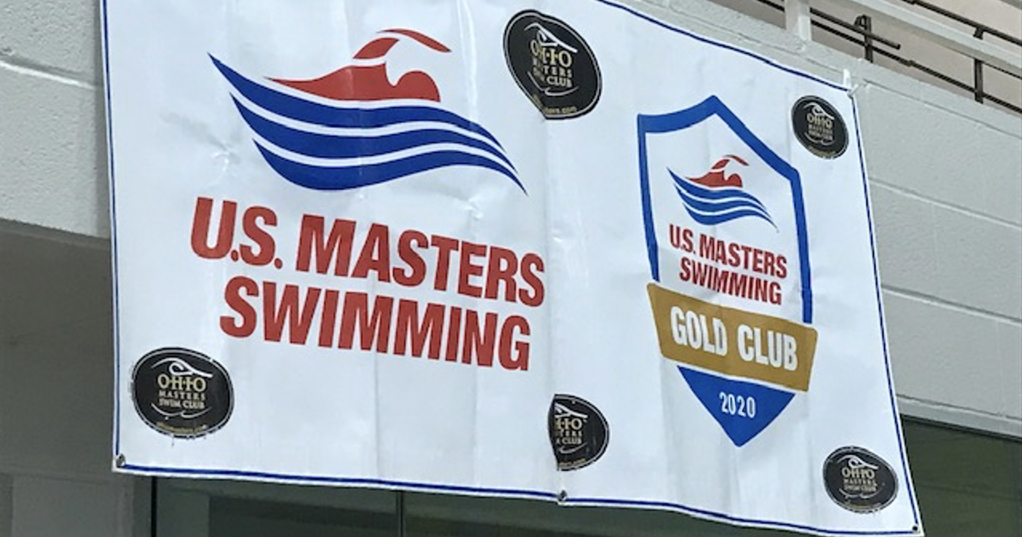

Slide 31
See you next year! Happy Swimming!

