Slide 1
WELCOME
O*H*I*O Masters Swim Club
Celebrations and Tributes
2022 Annual Meeting
Enjoy the following slides which offer celebrations and tributes to members of the Club during the past year.

Slide 3
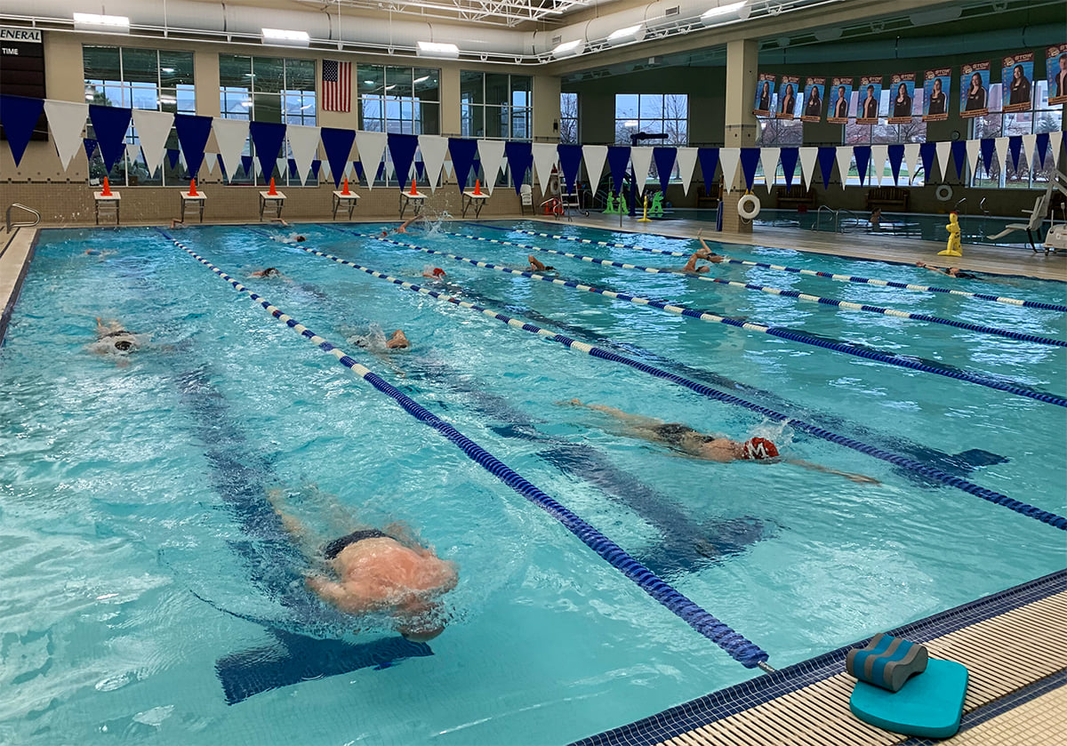
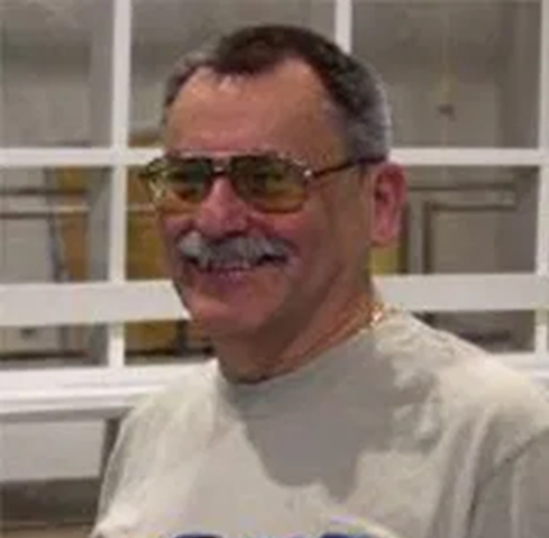
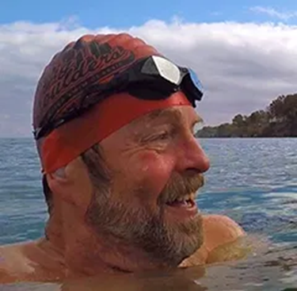
OUR COACHES
Bob Babiak
Chuck Beatty

Slide 4
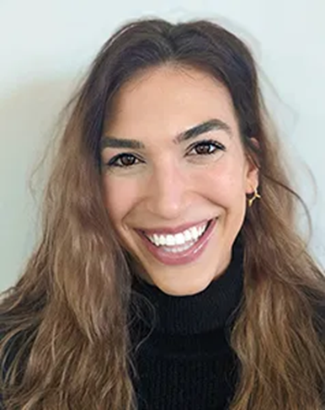
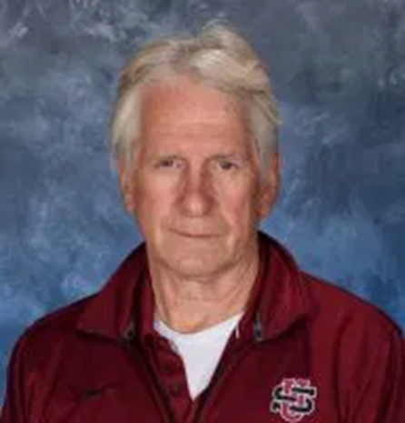
OUR COACHES
Marisa Celeste
Peter Finefrock

Slide 5
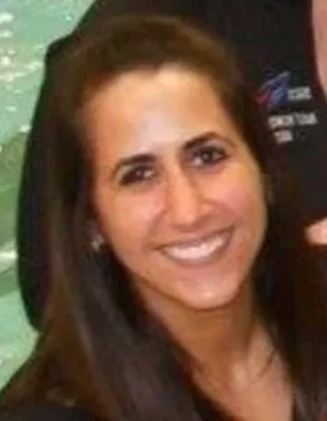
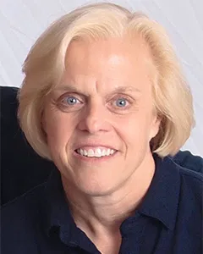
OUR COACHES
Gabby Kariotakis
Judi Norton

Slide 6
Mark Stewart
Barb Clary

Slide 8
Board Officers
President
Ann Marshfield
Vice President
Andrew McCollister

Slide 9
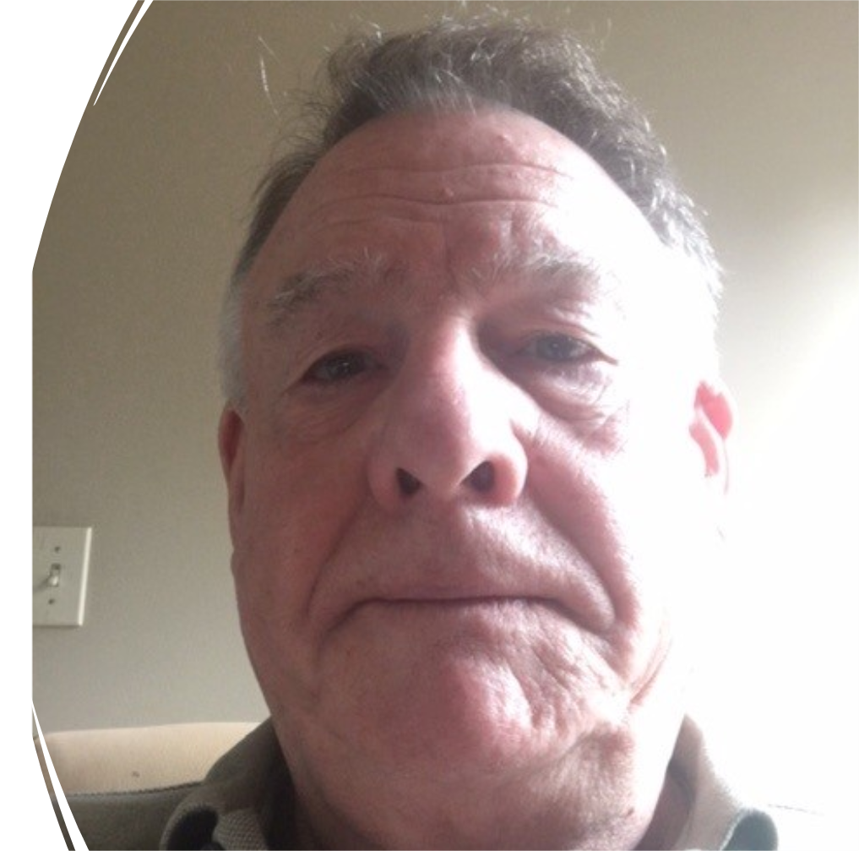
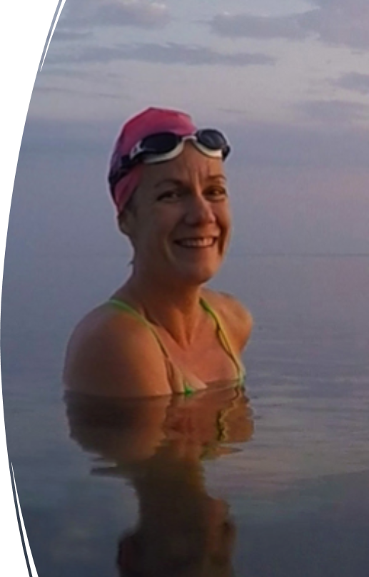
Board Officers
Treasurer
Bob Boyce
Secretary
Kristen Bergmann

Slide 10
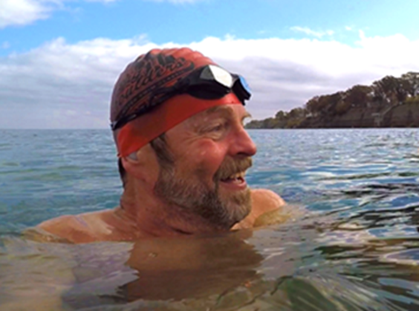
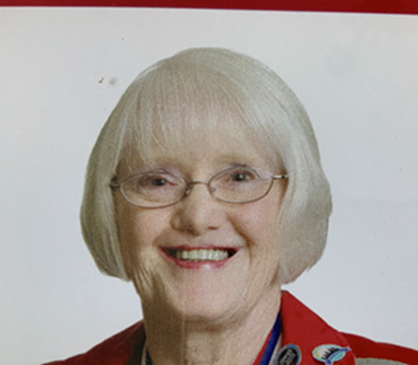
Board Trustees
Chuck Beatty
Anne Hegnauer

Slide 11
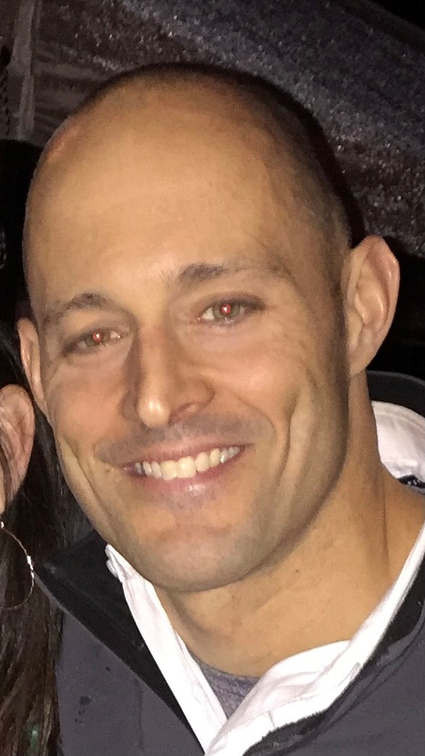
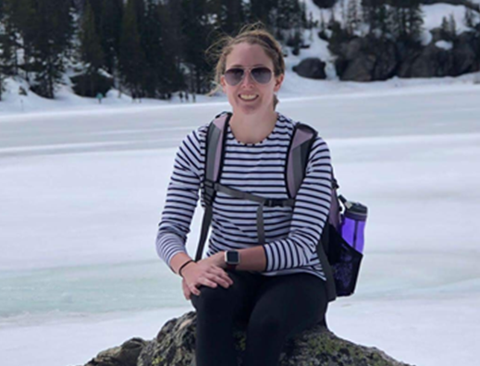
Board Trustees
Jim LaMastra
Ashley Leahy

Slide 12
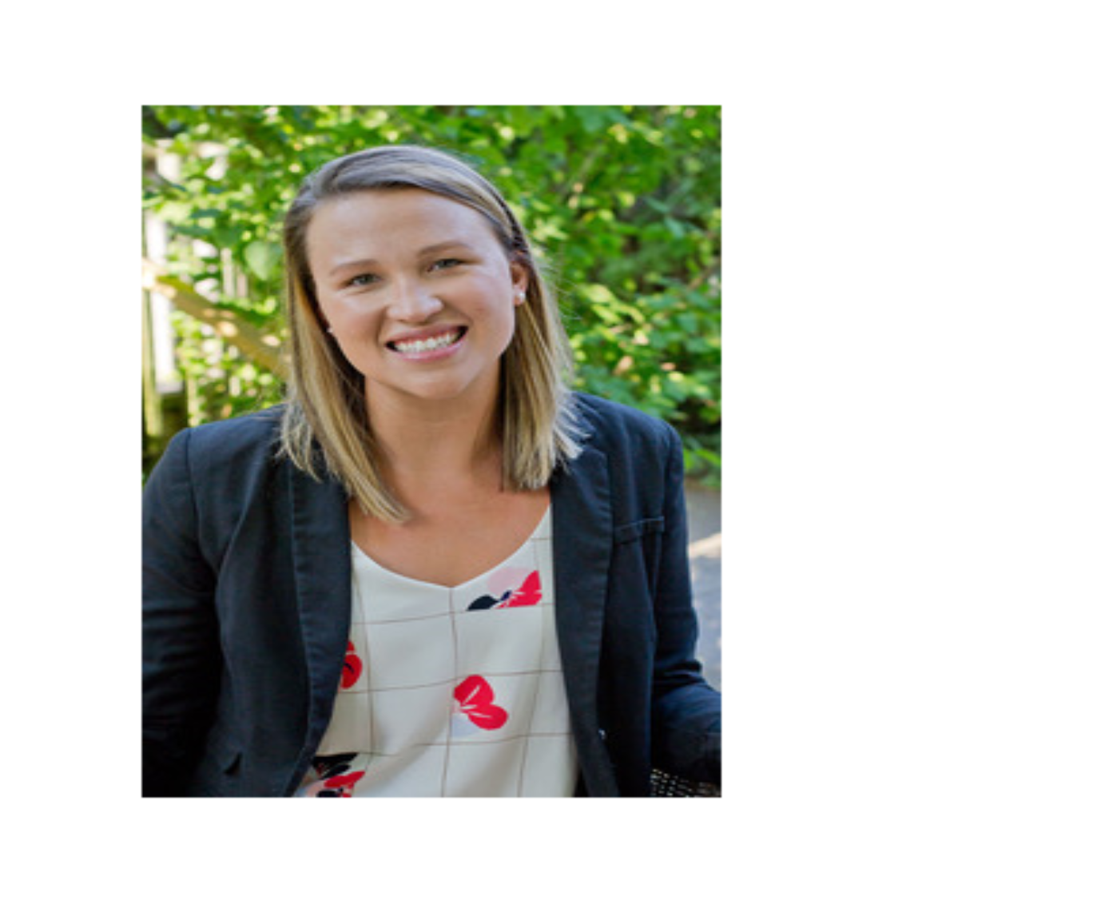
Board Trustees
Lori Luken
Sara Tillie

Slide 13
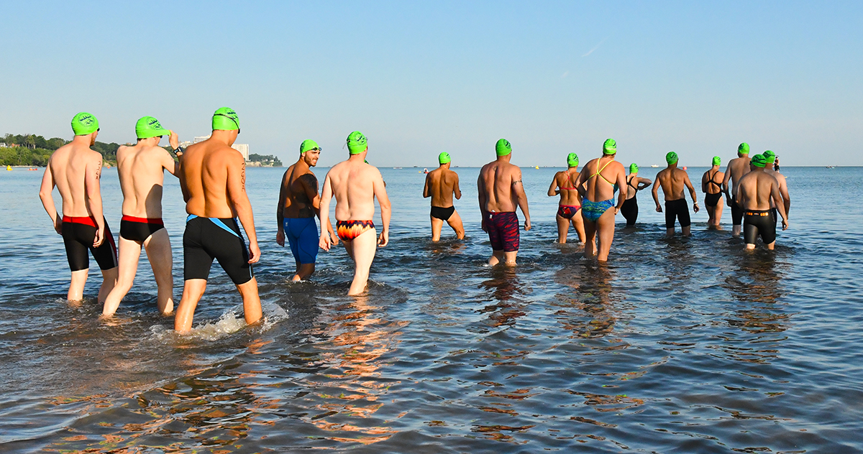
Brogan Open Water Classic (2019)

Slide 14
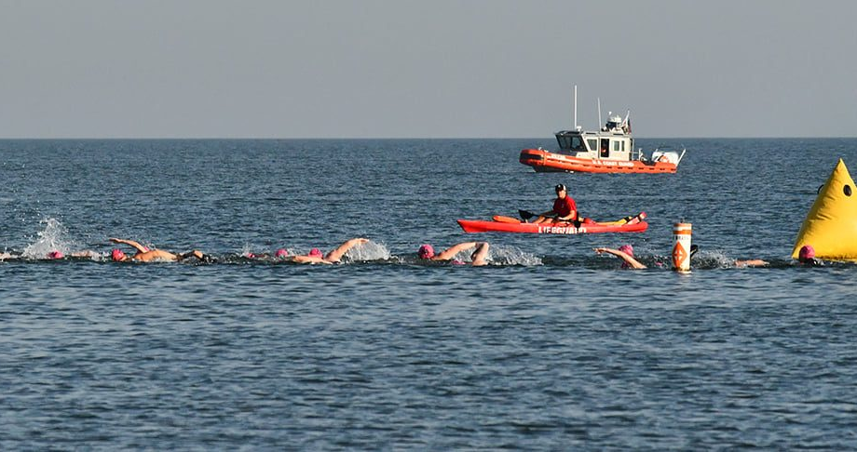

Slide 15
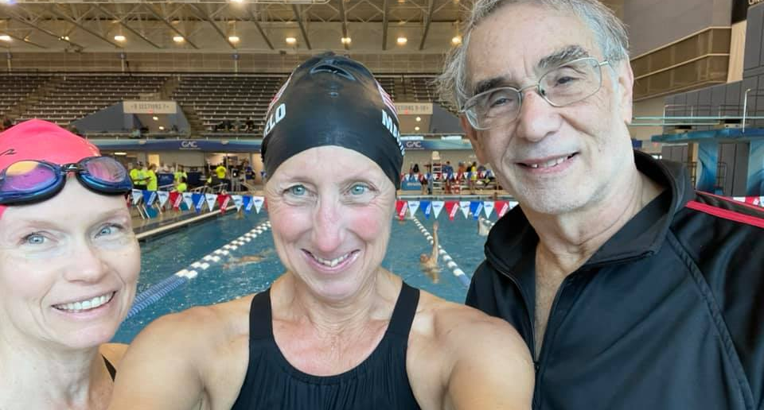
Short Course Yards National Championships – Greensboro, NC

Slide 16
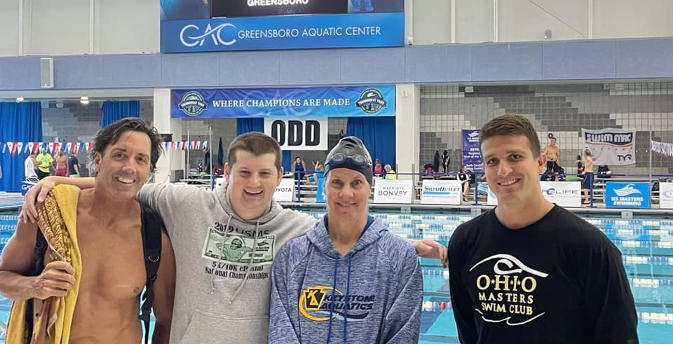
Short Course Yards National Championships – Greensboro, NC

Slide 17
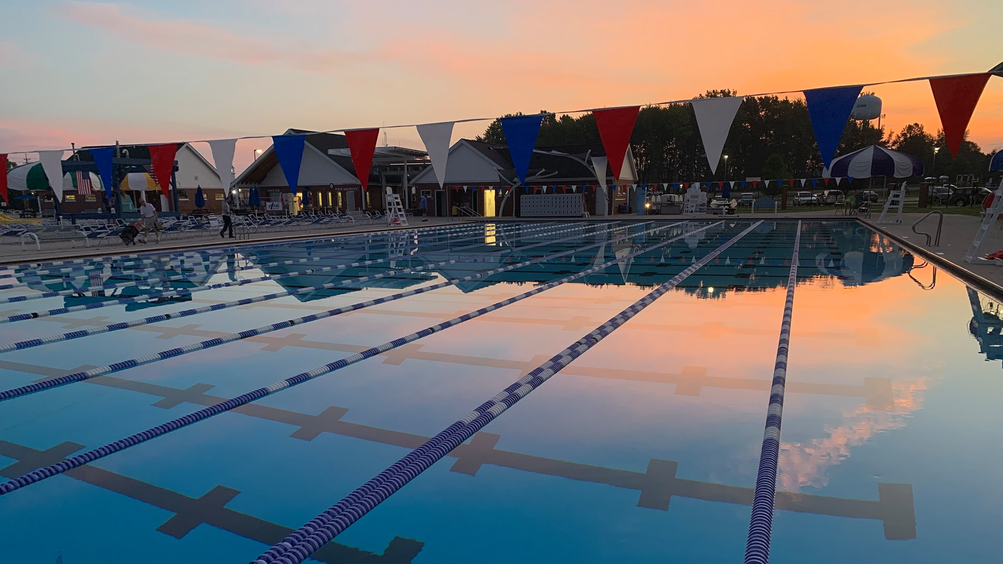
Sunrise at End of Summer Spectacular Swim Meet

Slide 18
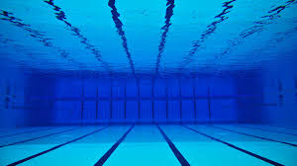
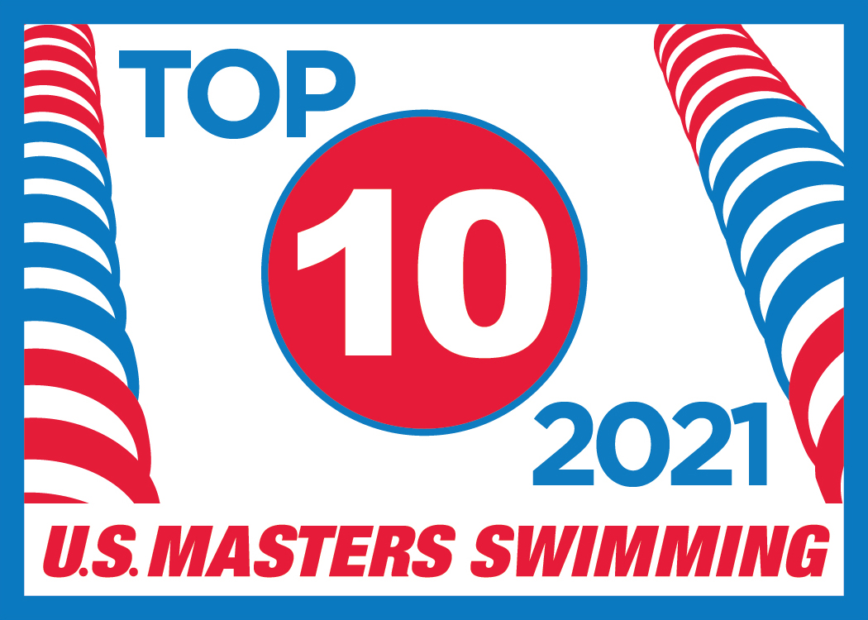
2021 Top 10 Short Course Yards
Individual

Slide 19
2021 Top 10 Short Course Yards
Individual
Dick Chisholm - 1000 Freestyle
Carol Detjen – 50 & 200 Freestyle
100 Breaststroke, 200 IM
Aaron Foreman – 1000 Freestyle, 200 IM

Slide 20
2021 Top 10 Short Course Yards
Individual
John Scalli
100 Freestyle,
50 &100 Backstroke
Melinda Smith
200 Butterfly

Slide 21
2021 Top 10 Short Course Yards
Individual
Larry Terkel
50 & 100 Freestyle
100 Breaststroke
Robert Williams
50 Butterfly,
100 IM, 200 IM

Slide 22
2021 Top 10 Short Course Meters
Individual

Slide 23
2021 Top 10 Short Course Meters
Individual
Edward Borsuk
200 & 400 Freestyle
Ashley Braniecki
200 Backstroke
100 Butterfly, 200 IM, 400 IM
Luise Easton – 50 Breaststroke
50, 100, 200 & 400 Freestyle

Slide 24
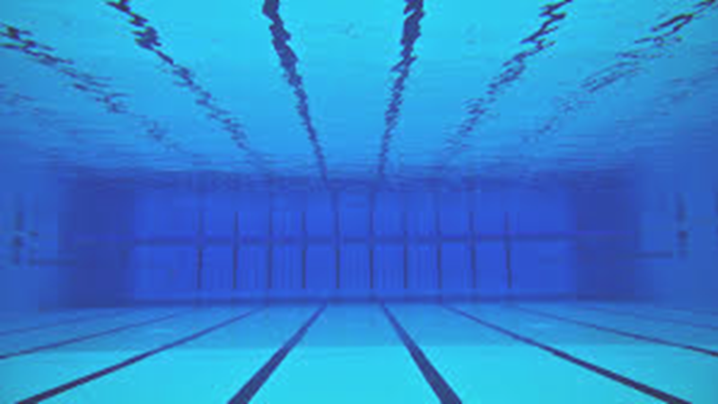
2021 Top 10 Short Course Meters
Individual
Sid Hall
100 & 200 Freestyle
David Kelso
200 Freestyle
Ann Marshfield
200 Breaststroke

Slide 25
2021 Top 10 Short Course Meters
Individual
Andrew McCollister
800 Freestyle
200 Breaststroke, 400 IM
Tim Moon
50 Backstroke
Chad Nance
100 & 200 Backstroke

Slide 26
2021 Top 10 Short Course Meters
Individual
Judi Norton
800 Freestyle
200 Backstroke, 400 IM
Susan Paris
200 & 400 Freestyle
Diane Spence
200, 400, 800 & 1500 Freestyle
200 Breaststroke

Slide 27
2021 Top 10 Short Course Meters
Individual
Kristi Tabaj
200 Backstroke,
200 Breaststroke, 200 IM
Larry Terkel
50 Freestyle

Slide 28
2021 Top 10 Short Course Meters
Relay

Slide 29
2021 Top 10 Short Course Meters - Relay
Mixed – 280-319 200 Free Relay
Larry Terkel, Susan Paris, Luise Easton, Edward Borsuk
Mixed – 280-319 200 Medley Relay
Luise Easton, Larry Terkel, Duane Grassell, Susan Paris

Slide 30
2021 Top 10 Short Course Meters - Relay
Mixed – 280-319 400 Medley Relay
Larry Terkel, Susan Paris, Luise Easton, Edward Borsuk
Mixed – 320-359 800 Free Relay
Sid Hall, Susan Paris, Luise Easton, Thomas Spence

Slide 31
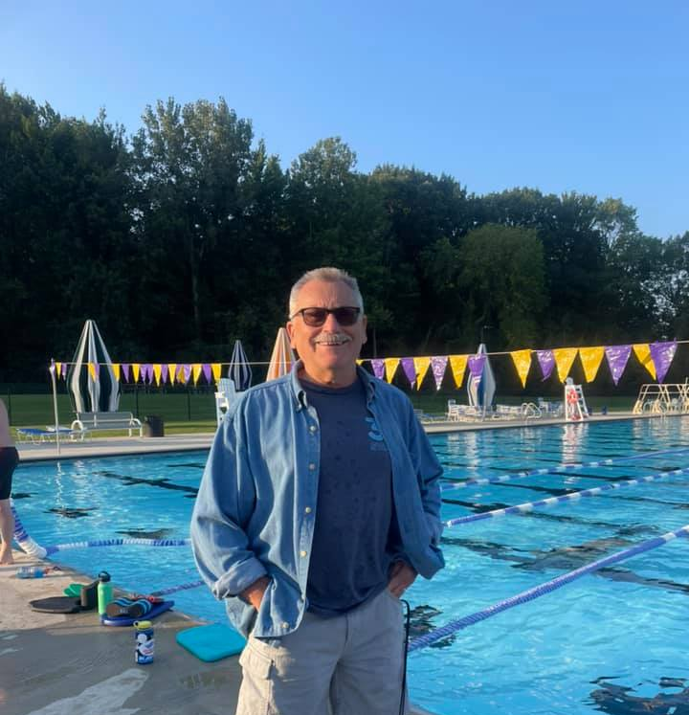
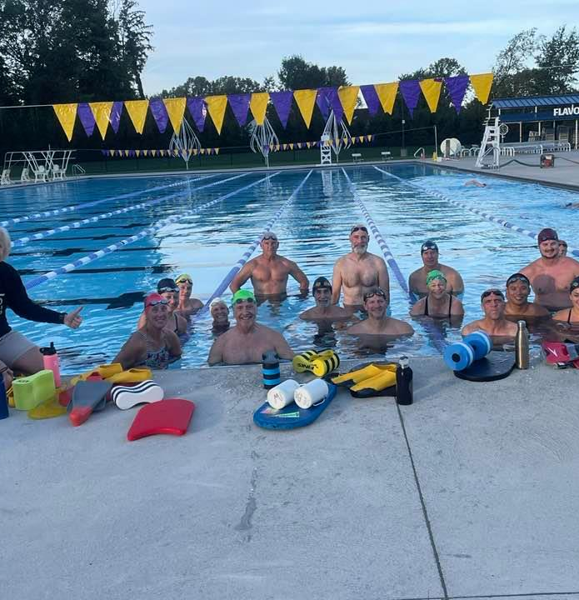
We extend our long course training outdoors at Avon Aquatics Center

Slide 32
2021 Top 10 Long Course Meters
Individual

Slide 33
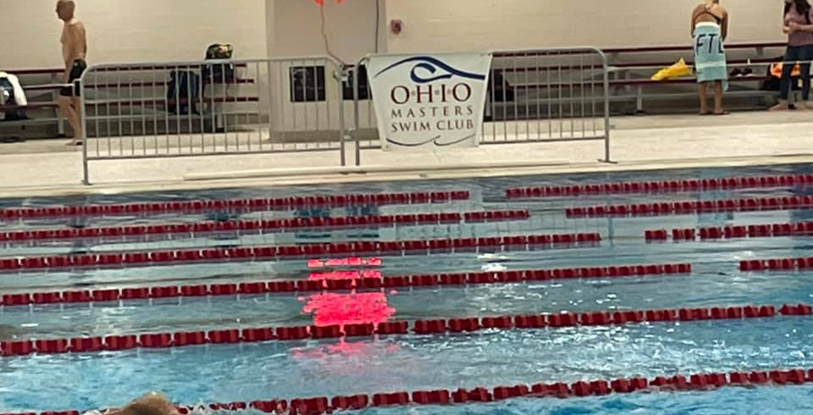
Long Course Nationals – SpireInstitute, Geneva, OH

Slide 34
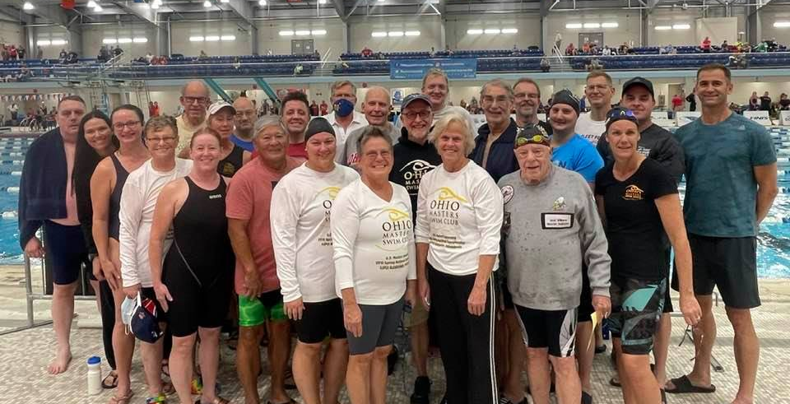
National Team for Long Course

Slide 35
2021 Top 10 Long Course Meters
Individual
Robert Babiak
50 Freestyle
50 Breaststroke
Arpad Batizy
200 & 1500 Freestyle, 400 IM
Kristen Bergmann
100 & 200 Freestyle, 50 & 100 Backstroke

Slide 36
2021 Top 10 Long Course Meters
Individual
Edward Borsuk
200 & 400 Freestyle
Ashley Braniecki
400 & 800 Freestyle
200 Backstroke
50, 100 & 200 Butterfly

Slide 37
2021 Top 10 Long Course Meters
Individual
Erin Cohn
50 & 100 Breaststroke
100 Butterfly, 400 IM
Luise Easton
50, 100, 200, 400, 800 & 1500 Freestyle
50 Breaststroke

Slide 38
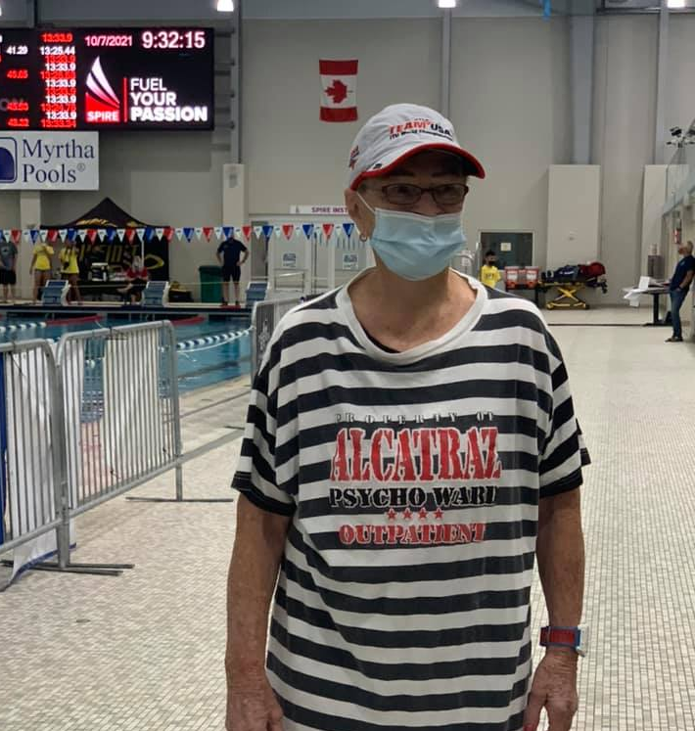
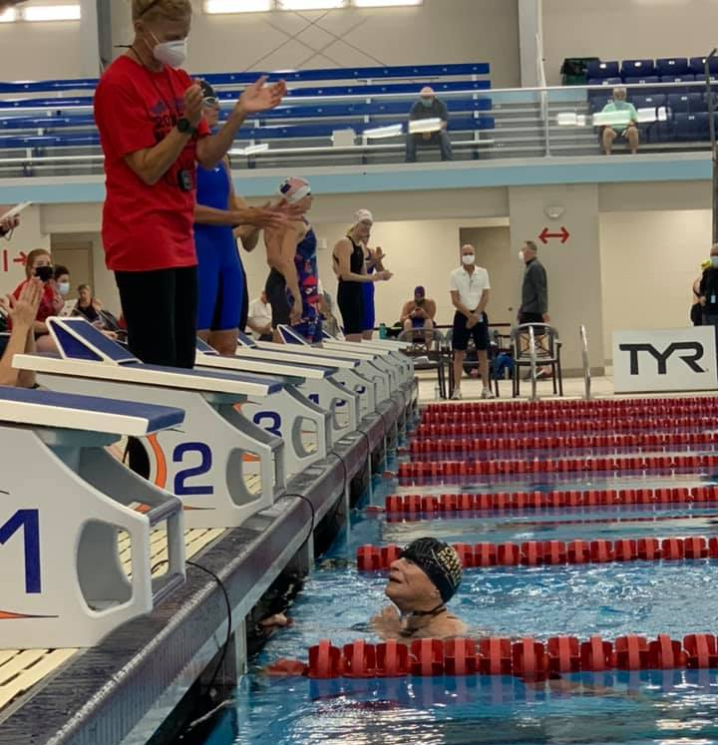
Luise Easton earns 7 Top 10 LCM Times!

Slide 39
2021 Top 10 Long Course Meters
Individual
Aaron Foreman
800 & 1500 Freestyle
200 Breaststroke & 400 IM
Duane Grassell
200 Butterfly

Slide 40
2021 Top 10 Long Course Meters
Individual
Sid Hall
50, 100 & 200 Freestyle
50 & 100 Backstroke
Ross Holloran
50 & 100 Freestyle

Slide 41
2021 Top 10 Long Course Meters
Individual
Ben Hartenburg
400 Freestyle
Jonathan Henning
400 Freestyle
100 Backstroke

Slide 42
2021 Top 10 Long Course Meters
Individual
Ann Marshfield
200 Breaststroke
Robert McDonald
200 Breaststroke

Slide 43
2021 Top 10 Long Course Meters
Individual
Mina Milad
100 Freestyle
50 & 100 Butterfly
Chad Nance
50, 100 & 200 Backstroke

Slide 44
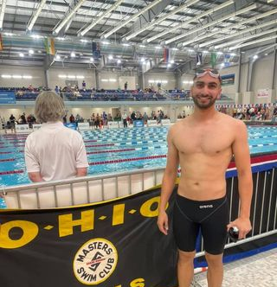
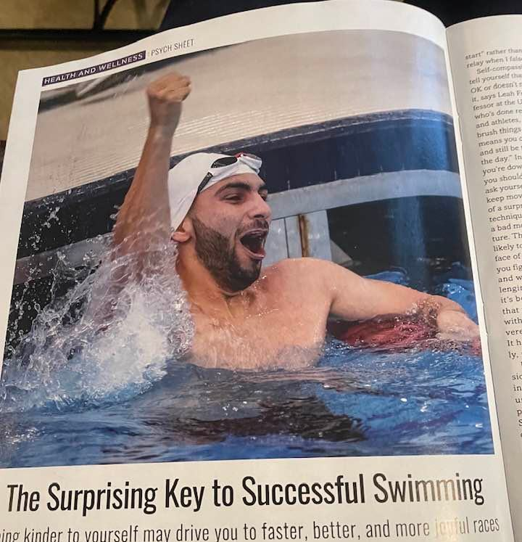
Mina Milad earns National Champion Title!

Slide 45
2021 Top 10 Long Course Meters
Individual
Judi Norton
1500 Freestyle
200 Backstroke
200 & 400 IM
Yoshi Oyakawa
50 & 100 Freestyle
50 & 100 Backstroke

Slide 46
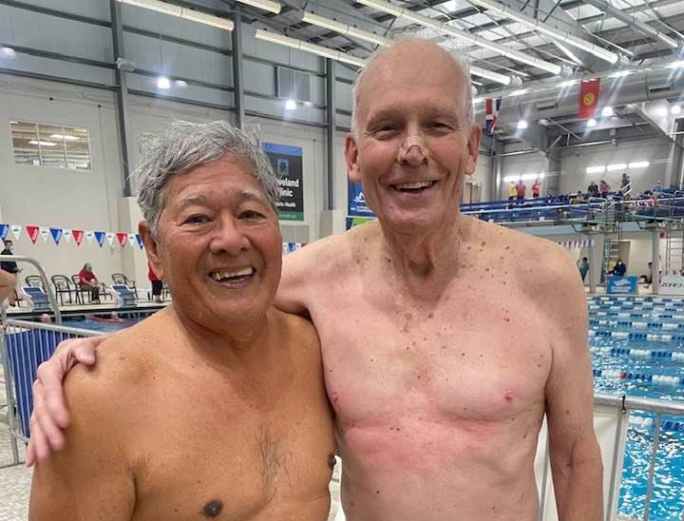
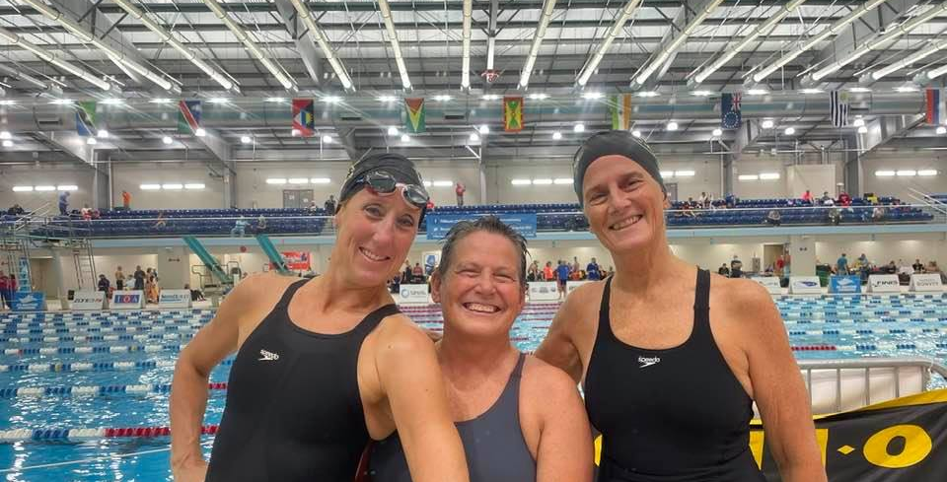
Yoshi Oyakawa at 88 years old earns National Champion Title!

Slide 47
2021 Top 10 Long Course Meters
Individual
Susan Paris
200 & 400 Freestyle
Cameron Rose
50, 100 & 200 Breaststroke
200 IM

Slide 48
2021 Top 10 Long Course Meters
Individual
Melinda Smith
200 Breaststroke
Kristi Tabaj
100 Backstroke

Slide 49
2021 Top 10 Long Course Meters
Individual
Diane Spence
400, 800 & 1500 Freestyle
100 & 200 Breaststroke
Tom Spence
1500 Freestyle

Slide 50
2021 Top 10 Long Course Meters
Individual
Larry Terkel
50 Freestyle
50 & 100 Breaststroke
Kristen Troyer
200, 400, 800 & 1500 Freestyle
200 IM

Slide 51
2021 Top 10 Long Course Meters
Individual
Greg Turocy
50 & 200 Breaststroke
Robert Williams
400 & 800 Freestyle
50 Butterfly
200 IM

Slide 52
2021 Top 10 Long Course Meters
Relay

Slide 53
2021 Top 10 Long Course Meters
Relay
Women 120-159 200 Free Relay
Ashley Braniecki, Andrea Hahn-Lawson
Kristi Tabaj, Erin Cohn
Women 160-199 200 Medley Relay
Andrea Hahn-Lawson, Kristen Bergmann
Ashley Braniecki, Cynthia Druckenbrod

Slide 54
2021 Top 10 Long Course Meters
Relay
Women – 240-279 200 Free Relay
Kristen Bergmann, Ann Marshfield
Judith Norton, Diane Spence
Women – 280-319 200 Medley Relay
Diane Spence, Ann Marshfield
Melinda Smith, Luise Easton

Slide 55
2021 Top 10 Long Course Meters
Relay
Men 100-119 400 Free Relay
John Scalli, Jonathan Henning
Thomas Dinh, Aaron Foreman
Men 160-199 200 Medley Relay
Chad Nance, Cameron Rose
Aaron Foreman, Ross Halloran

Slide 56
2021 Top 10 Long Course Meters
Relay
Men 280-319 200 Medley Relay
Sid Hall, Larry Terkel
Jay Definis, Kevin McCardle
Men 320-359 200 Free Relay
Sid Hall, Tom Spence
Mario Gerhardt, Robert Williams

Slide 57
2021 Top 10 Long Course Meters
Relay
Men 320-359 200 Medley Relay
Yoshi Oyakawa, Arpad Batizy
Robert Williams, Mario Gerhardt

Slide 58
2021 Top 10 Long Course Meters
Relay
Mixed 100-119 200 Medley Relay
Aaron Foreman, Erin Cohn
Tom Dinh, Kristen Troyer
Mixed 240-279 800 Free Relay
Chuck Beatty, Kristen Bergmann
Diane Spence, Edward Borsuk

Slide 59
2021 Top 10 Long Course Meters
Relay
Mixed 280-319 200 Free Relay
Larry Terkel, Ann Marshfield
Luise Easton, Dan Cox
Mixed 280-319 200 Free Relay
Robert Williams, Melinda Smith
Diane Spence, Mario Gerhardt

Slide 60
2021 Top 10 Long Course Meters
Relay
Mixed 100-119 200 Medley Relay
Aaron Foreman, Erin Cohn
Tom Dinh, Kristen Troyer
Mixed 240-279 800 Free Relay
Chuck Beatty, Kristen Bergmann
Diane Spence, Edward Borsuk

Slide 61
2021 Top 10 Long Course Meters
Relay
RELAY ALL-AMERICAN
Mixed 320-359 200 Medley Relay
Yoshi Oyakawa, Melinda Smith
Robert Williams, Luise Easton

Slide 62
2021 INDIVIDUAL
ALL-AMERICAN
Luise Easton – 1500 FREESTYLE
Kristen Troyer – 800 & 1500 FREESTYLE
Yoshi Oyakawa – 100 BACKSTROKE

Slide 63
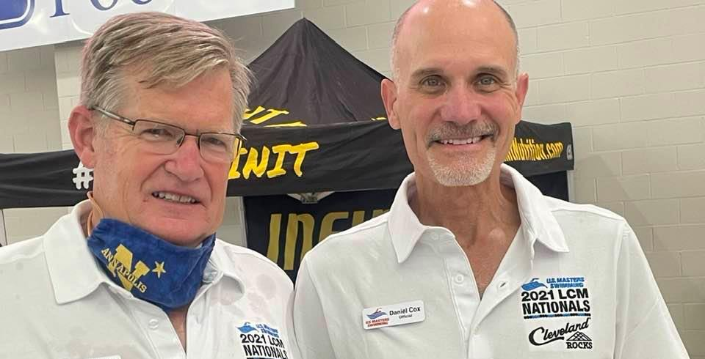
Officials Mark Marshfield & Dan Cox

Slide 64
The Club places 3rd

Slide 65
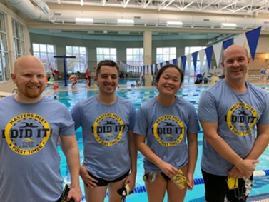
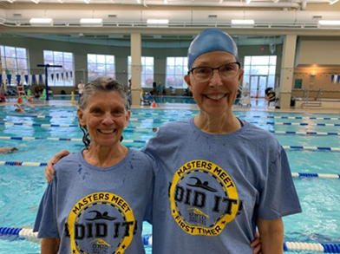
First Timers – Pentathlon Swim Meet

Slide 66
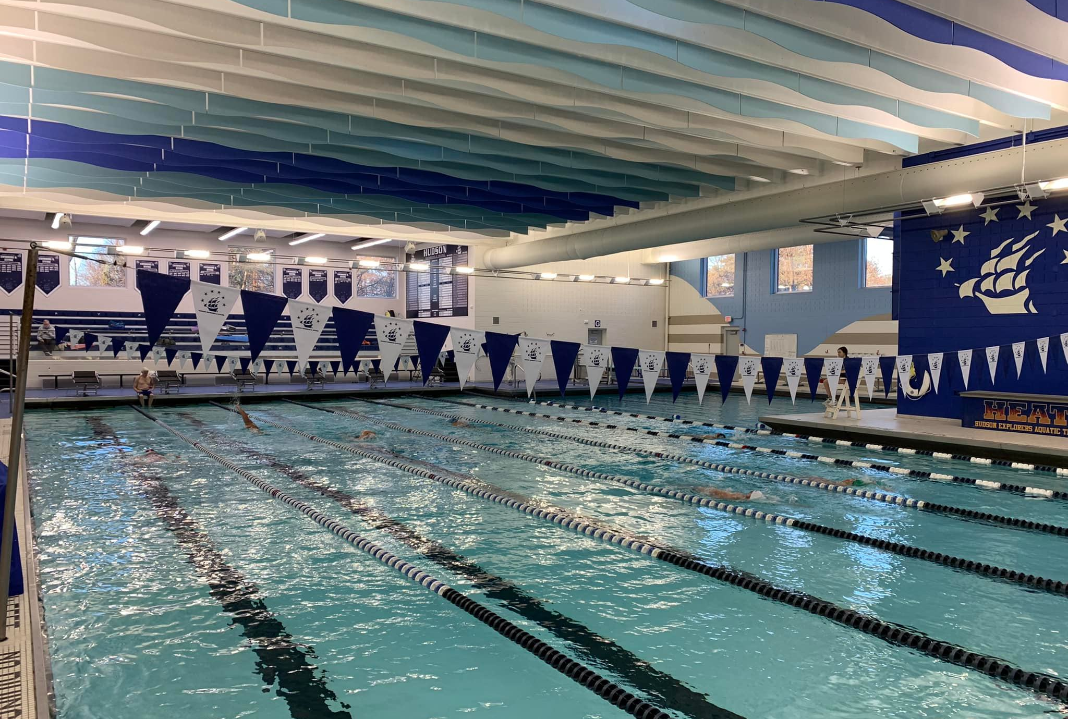
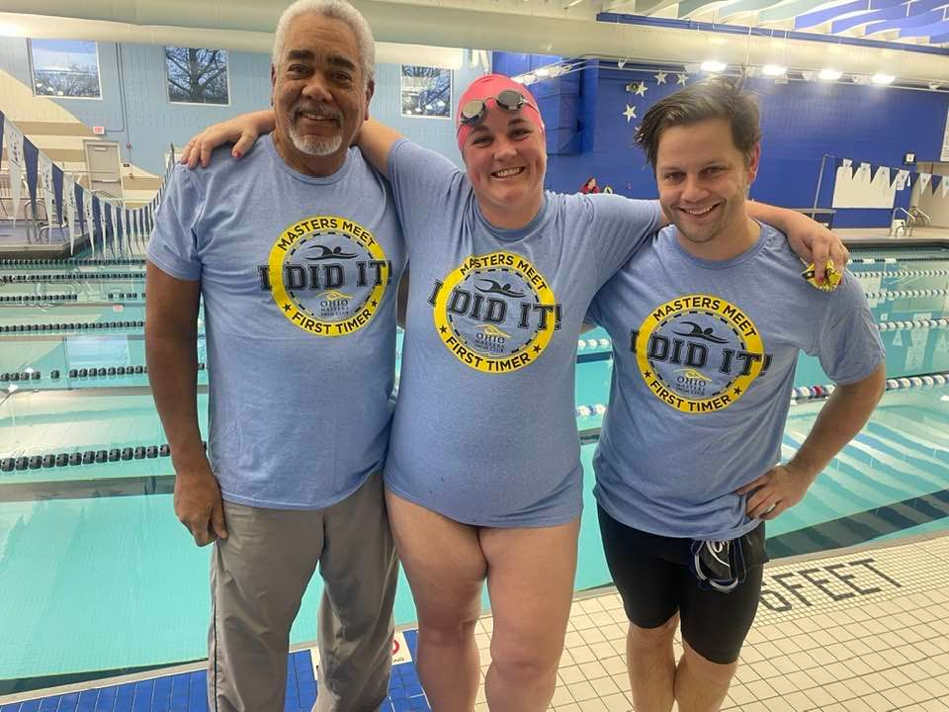
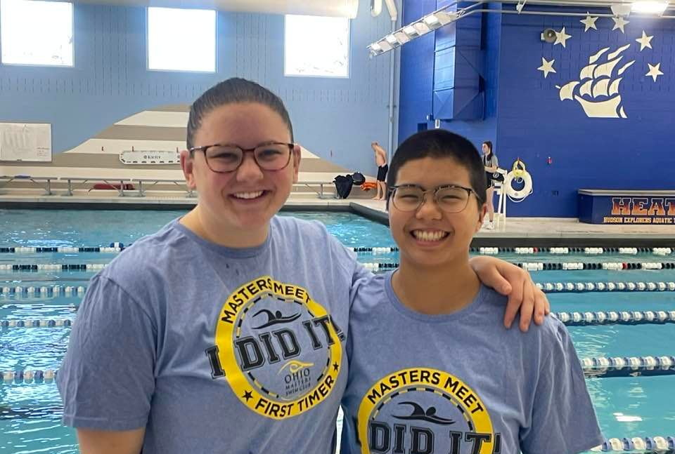
First Timers – Hudson SCM Swim Meet

Slide 67
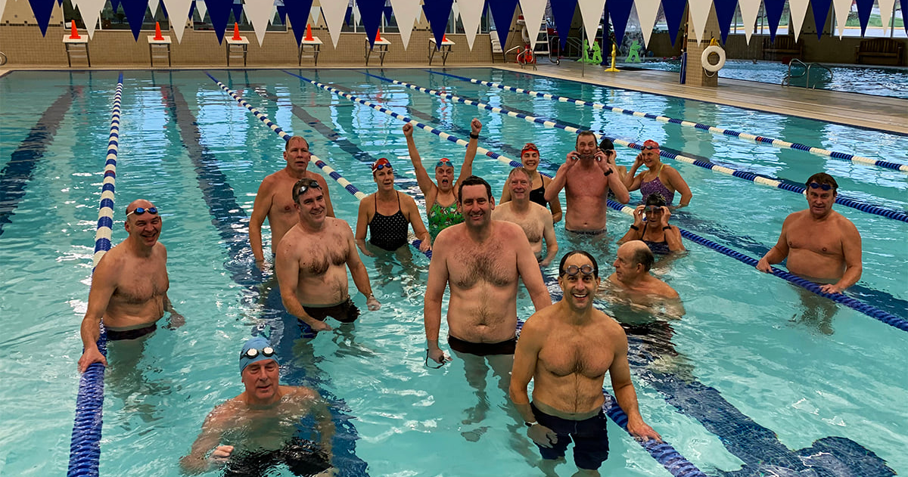
New Year’s Day workout! Thanks Chuck Beatty!!

Slide 68
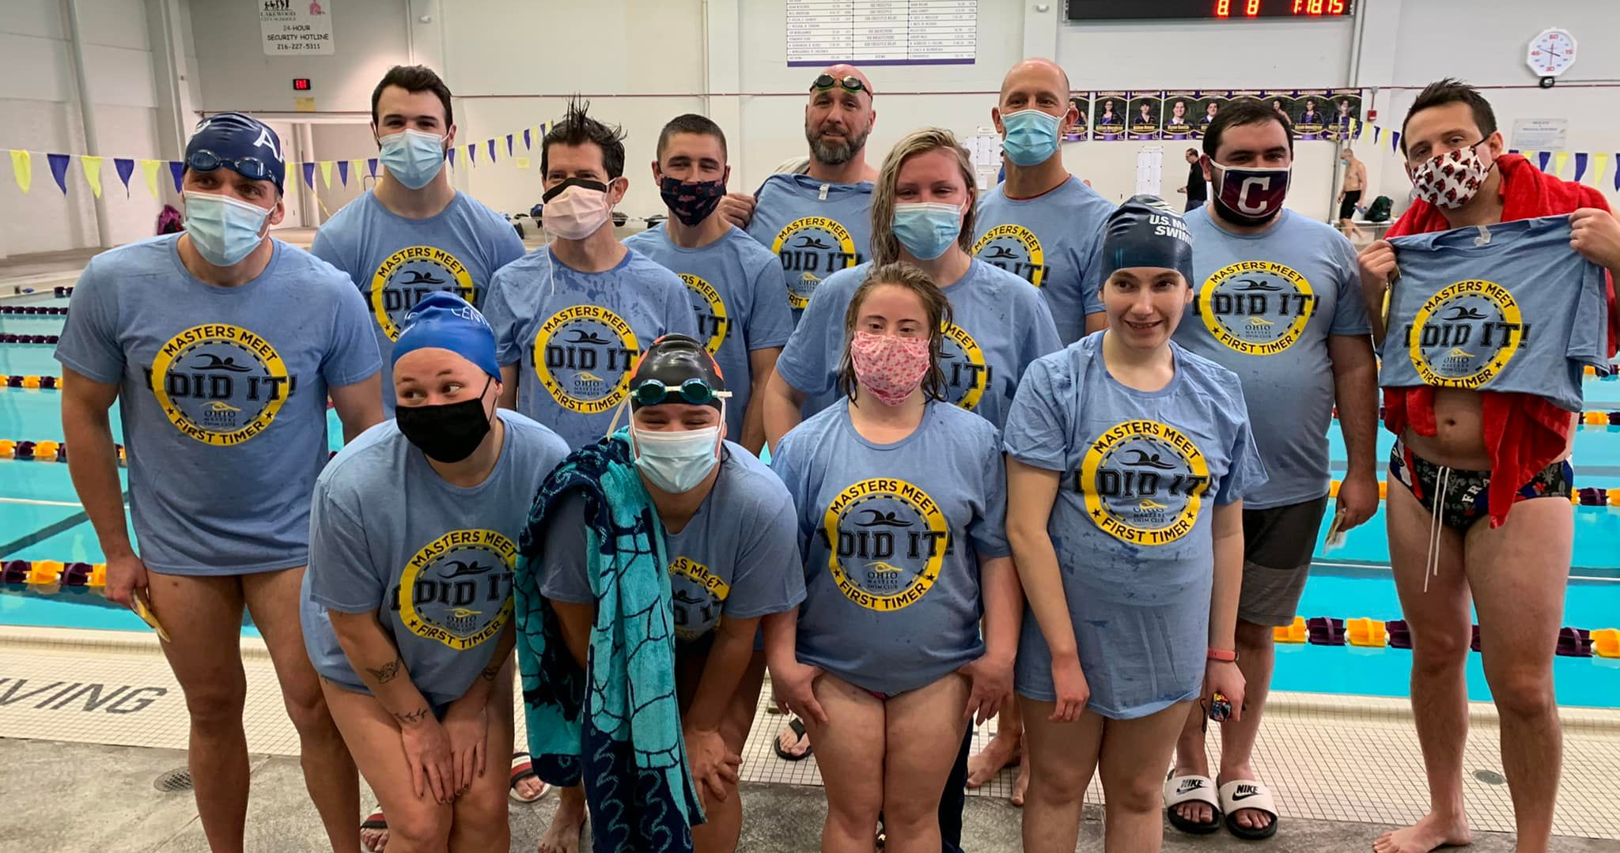
First Timers at Pieter Cath Memorial Swim Meet

Slide 69
Aaron Foreman proposes pool side!! She said YES!!

Slide 70
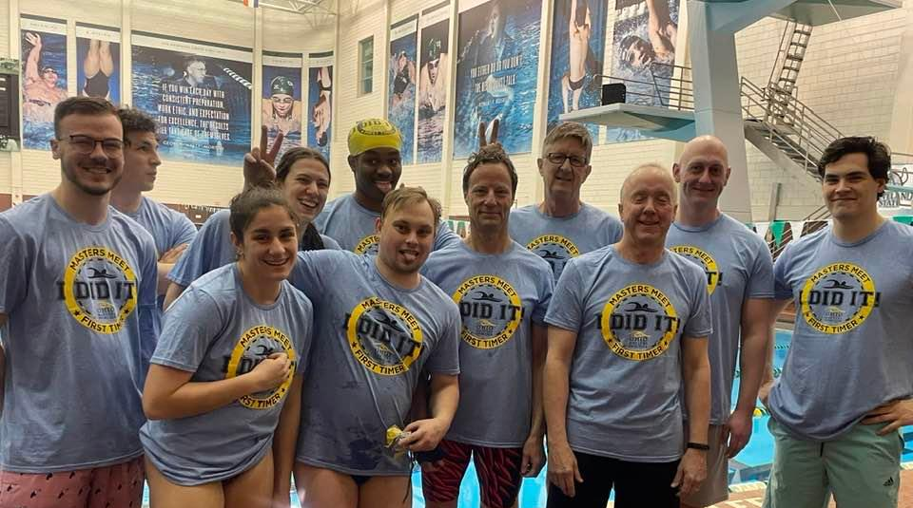
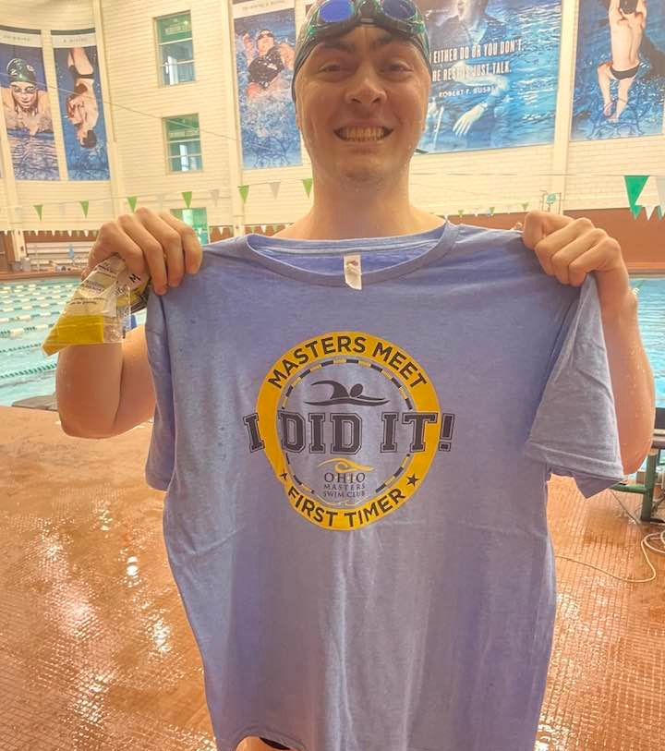
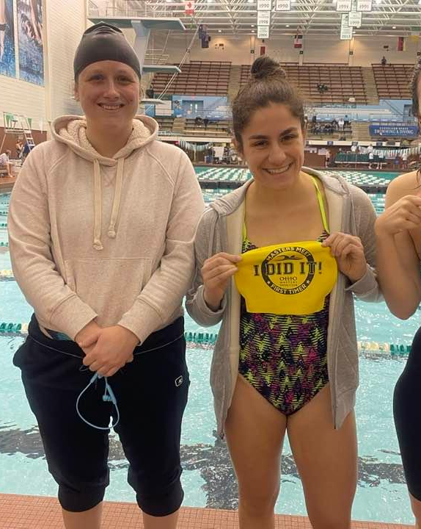
First Timers at
Cleveland State Swim Meet
March 27, 2022

Slide 71
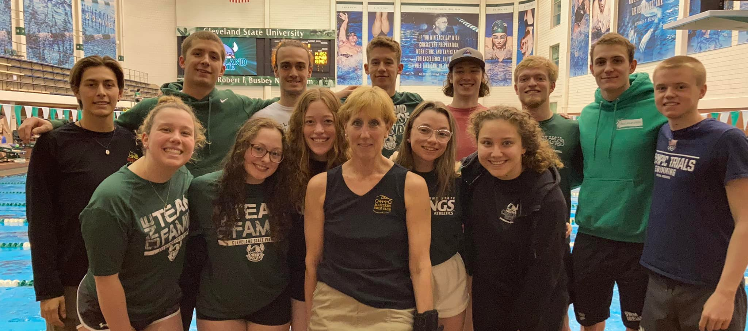
Thank You CSU Swim & Dive Team

Slide 72
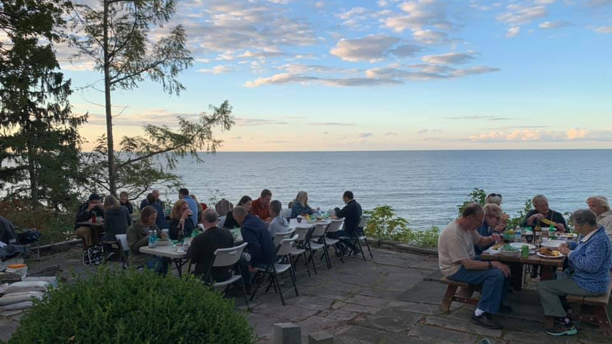
Clam Bake at Mike & Kristen Bergmann’s

Slide 73
2021 USMS 1-Hour ePostal Top 10
Individual
Aaron Foreman
Chuck Beatty
Tom Spence
Diane Spence

Slide 74
2021 USMS 1-Hour ePostal Top 10
Relay
Men’s
Aaron Foreman, Duane Grassell, Chuck Beatty
Jay DeFinis, Charles Gerheim, Tom Spence
Mixed
Aaron Foreman, Flavia Medlin,
Chuck Beatty, Diane Spence

Slide 75
2021 USMS 5k ePostal Top 10
Individual
Aaron Foreman
Chuck Beatty
Flavia Medlin

Slide 76
2021 USMS 10k ePostal Top 10
Individual
Aaron Foreman
Flavia Medlin

Slide 77
2021 USMS 3000 ePostal Top 10
Individual
Ashley Braniecki
Chuck Beatty
Charles Gerheim

Slide 78
2021 USMS 3000 ePostal Top 10
Relay
Men’s
Chuck Beatty, Duane Grassell, Charles Gerheim,
Mixed
Ashley Braniecki, Flavia Medlin,
Duane Grassell, Chuck Beatty

Slide 79
2021 USMS 6000 ePostal Top 10
Individual
Flavia Medlin
Chuck Beatty
Duane Grassell

Slide 80
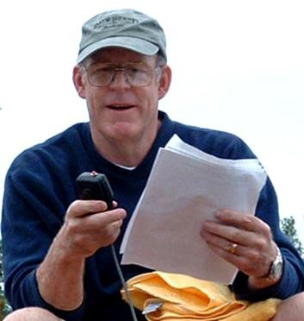
O*H*I*O Masters Swim Club
Lifetime Achievement Award
Tom Spence
President - O*H*I*O Masters Swim Club
Chair - Lake Erie LMSC
Meet Director – O*H*I*O Open Water Swim
Coordinator – USMS LCM National Championships
Meet Director – USMS 1-Hour ePostal
Coordinator – National Gay Games Championships
Member – USMS Long Distance Committee
Member – USMS Championship Committee
2012 USMS Dorothy Donnelly Service Award

